Slide 1

(Churn Modiling)
Project Based on Bank Customer
(Churn Modiling)

Slide 2
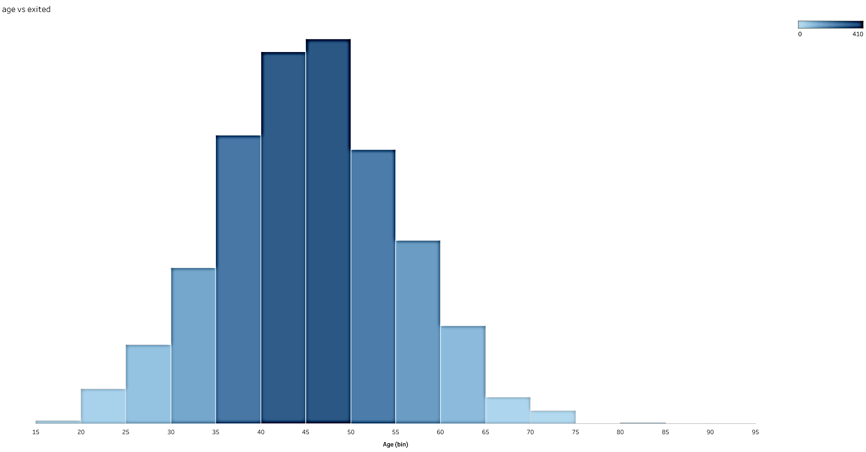
For which age range customers have exited ?

Slide 3
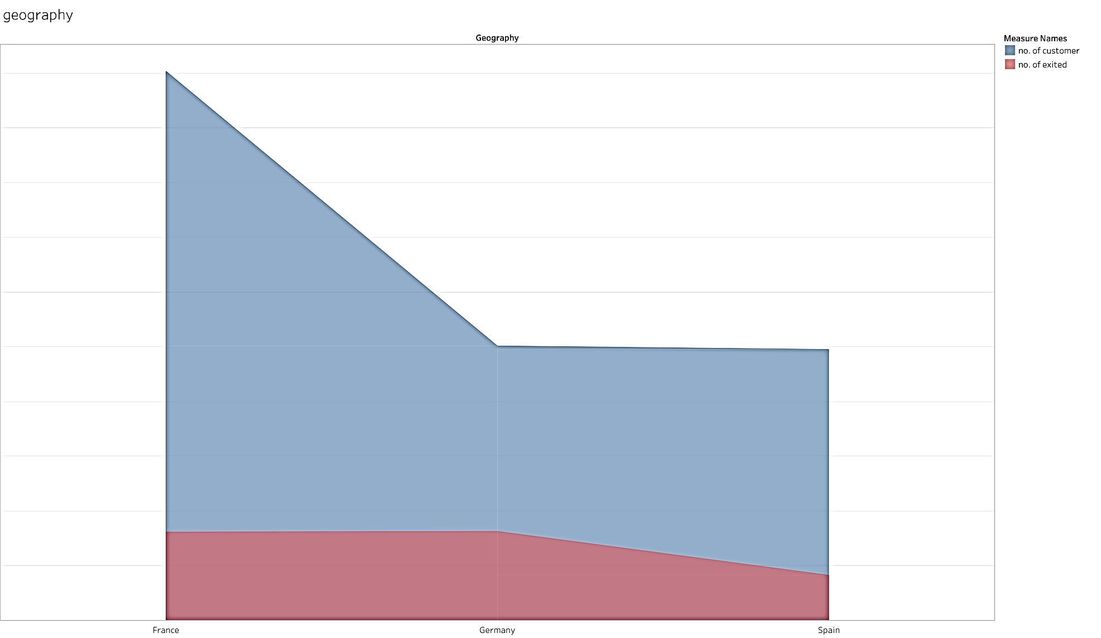
How many customers are there in which country and how many customers have exited out of them?

Slide 4
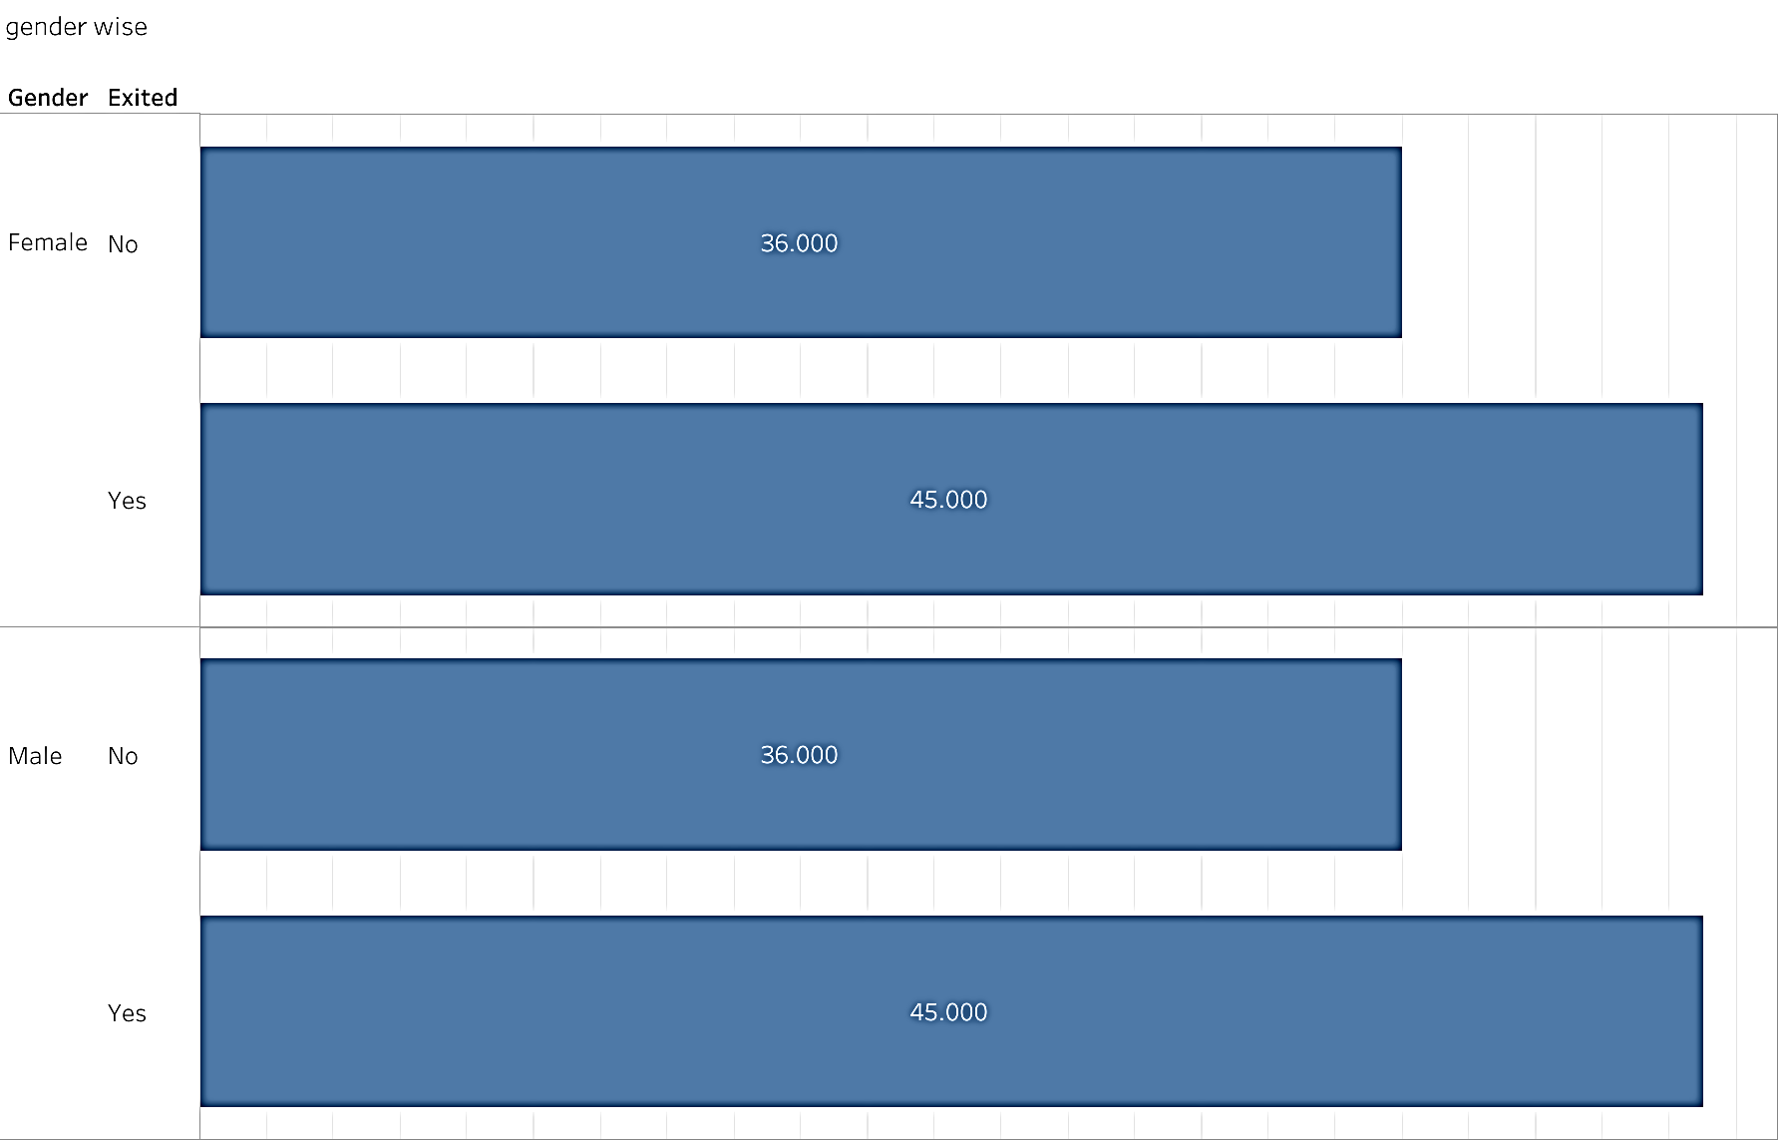
How many male and female customers have exited ?

Slide 5
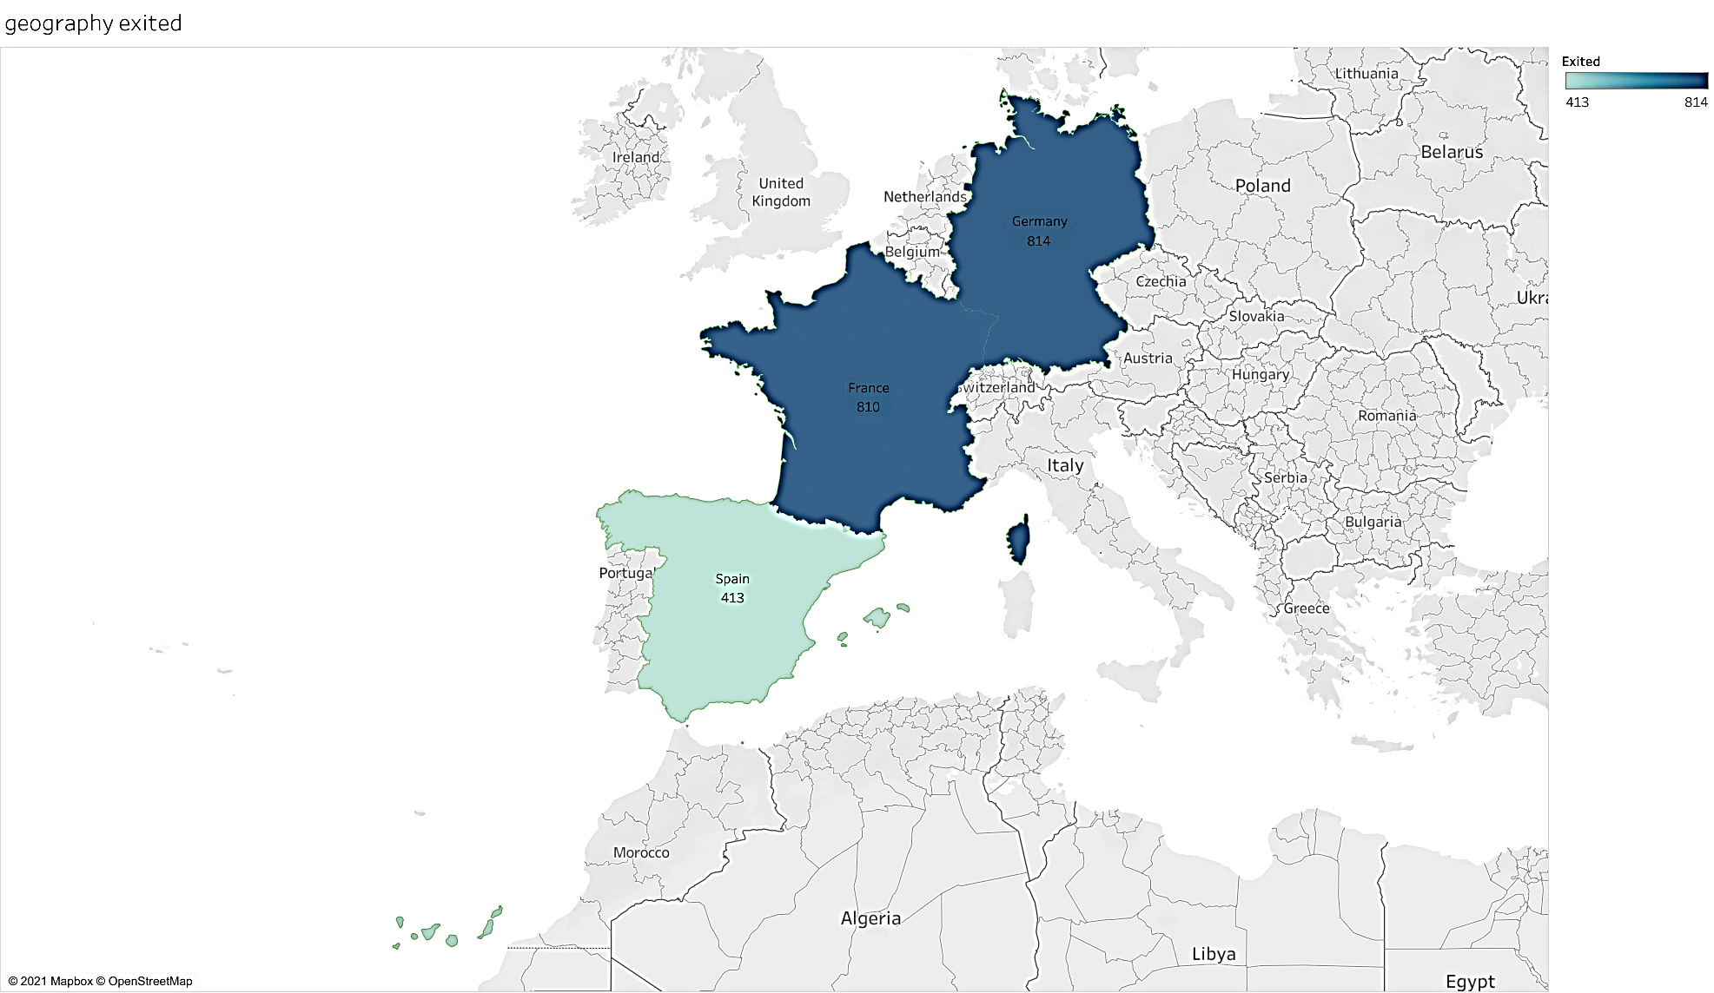
How many customers have exited in which country ?

Slide 6
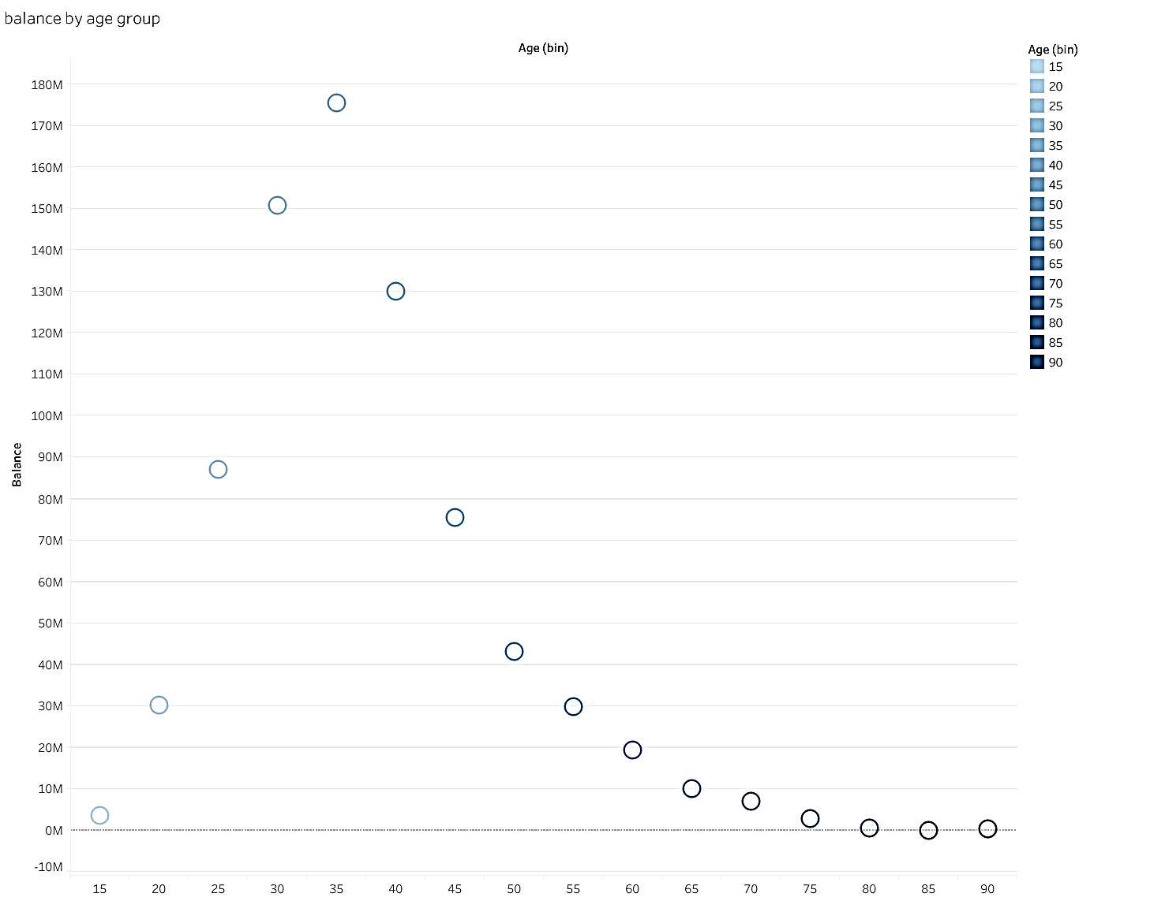
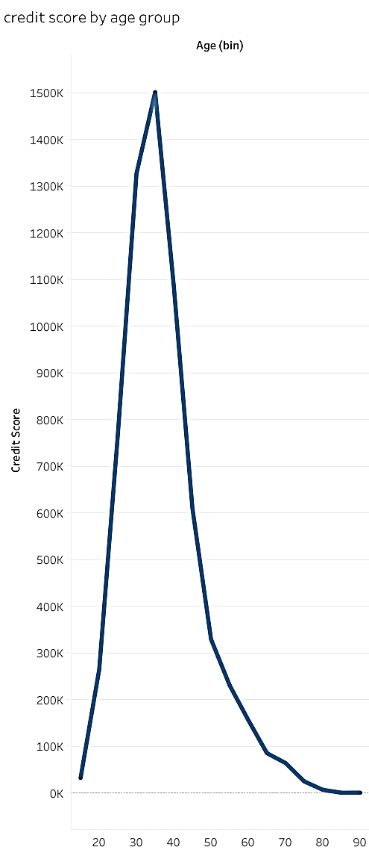
According to which age range , which customer has how much balance ?
According to which age range , which customer has how much credit score ?

Slide 7
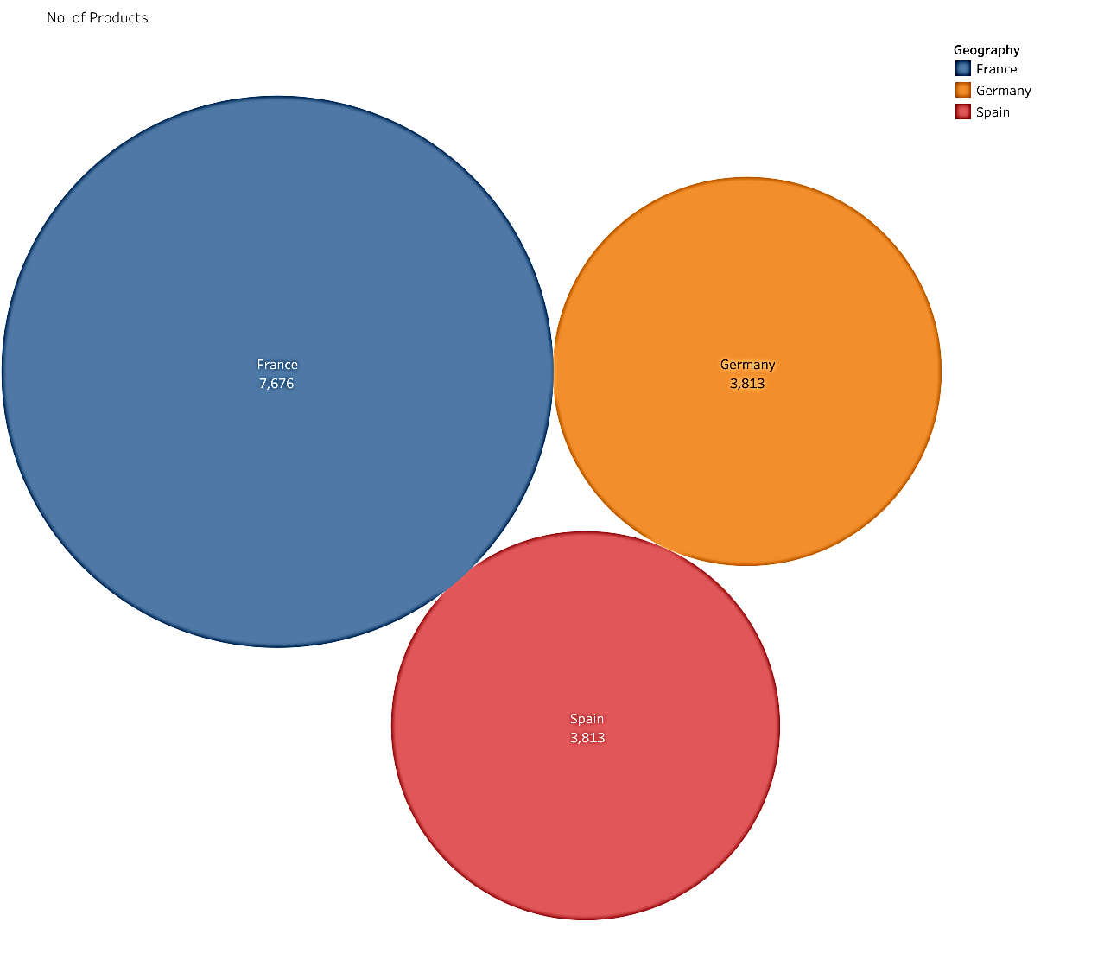
Which country has how many number of products ?

Slide 8
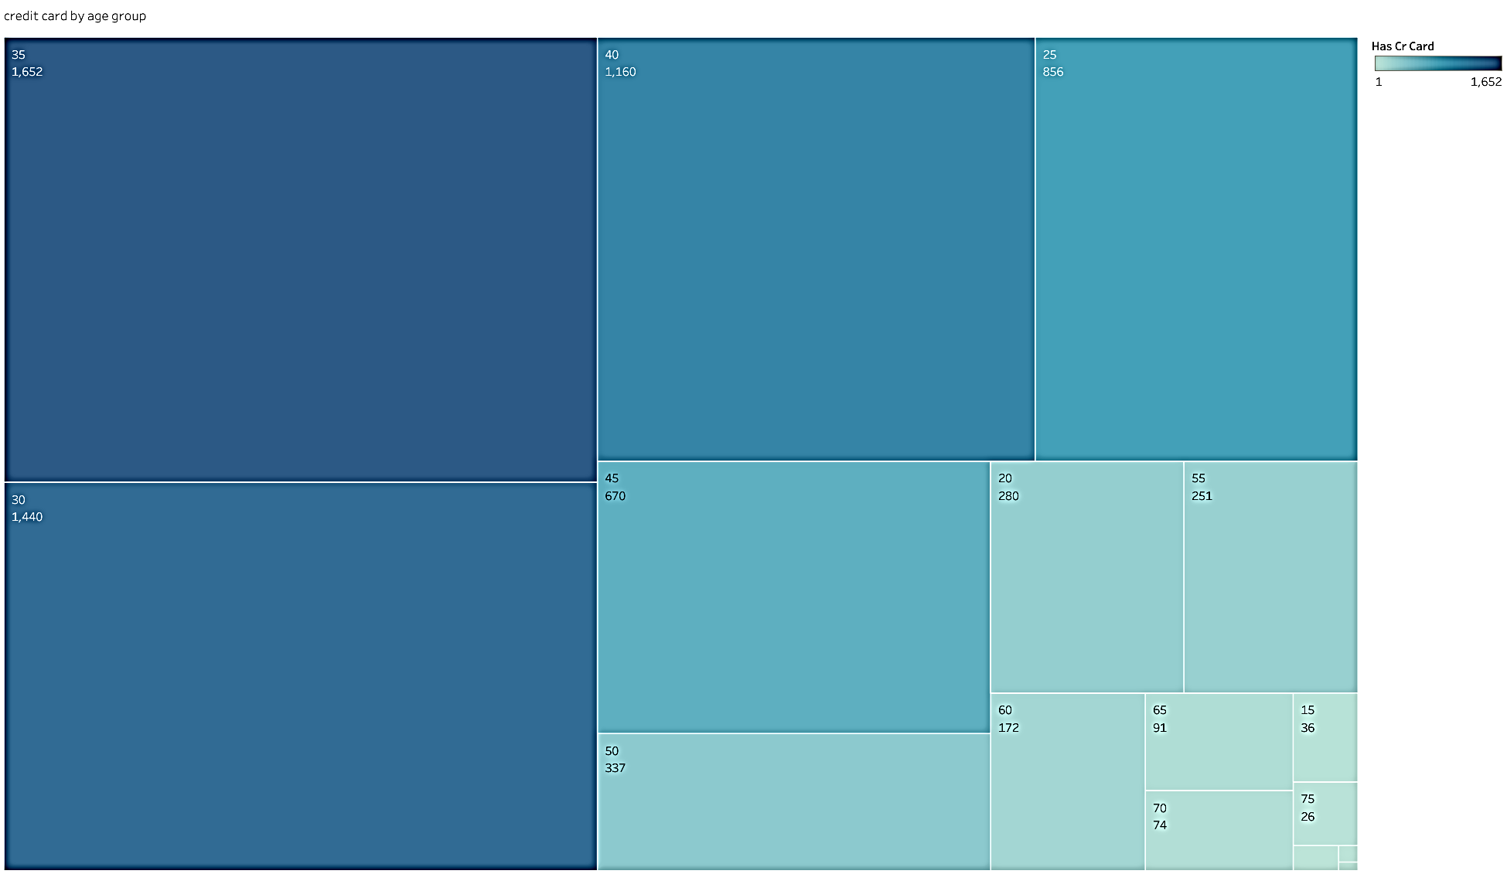
Which age group the customer has the credit card ?

Slide 9
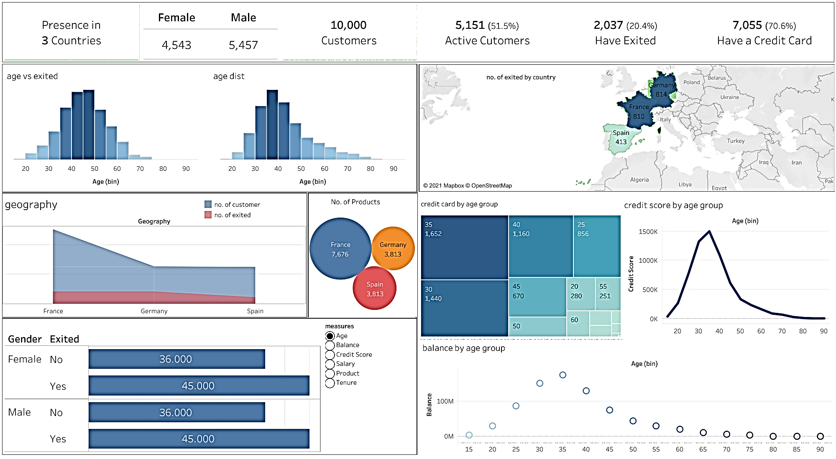

Slide 10

THANK YOU!
Created by
Kamal Pratap singh

